Slide 1
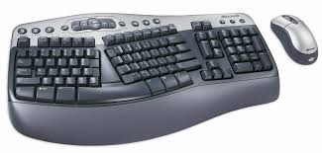

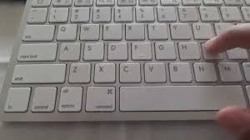
HARDWARE
Input Devices: An input device is a piece of computer hardware equipment used to provide data.
Mechanical Keyboard Membrane Keyboard Multimedia Keyboard

Slide 2
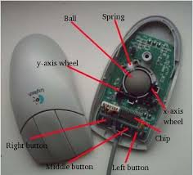
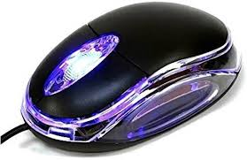
Mouse:
A small handheld device which is used to move the cursor on a computer screen.
Optical Mouse
Mechanical mouse

Slide 3

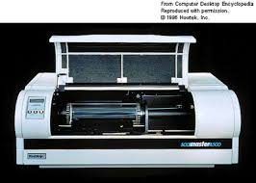
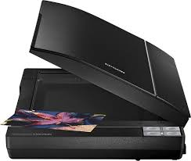
Scanner: A hardware device that scans documents and converts them into digital data.
Flatbed scanner
Drum scanner
Handheld scanner

Slide 4
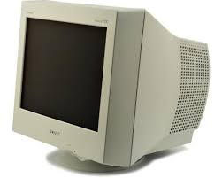
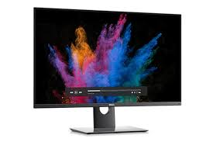
Output Devices
The hardware devices that converts a computer's output to a form that can be seen or heard on the computer. Monitor:
CRT Monitor
LCD Monitor

Slide 5
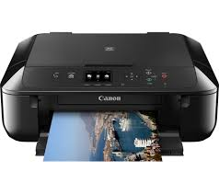
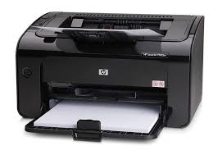
Printer:
A printer is a device that accepts text and graphic output from a computer and transfers the information to paper.
Laser printer
Ink jet printer

Slide 6
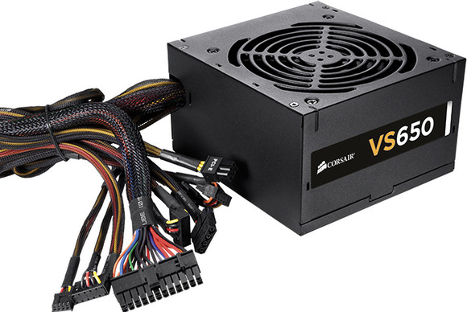
SMPS
Switch Mode Power Supply(SMPS) is a type of Power Supply Unit (PSU) that uses some kind of switching devices to transfer electrical energy from source to load.

Slide 7
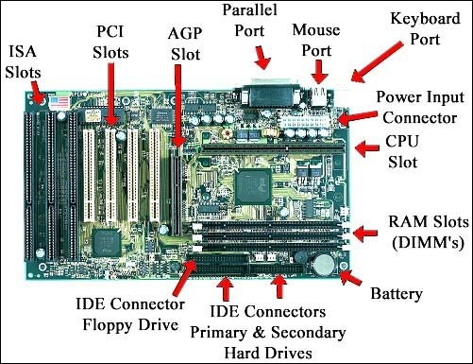
Mother Board

Slide 8
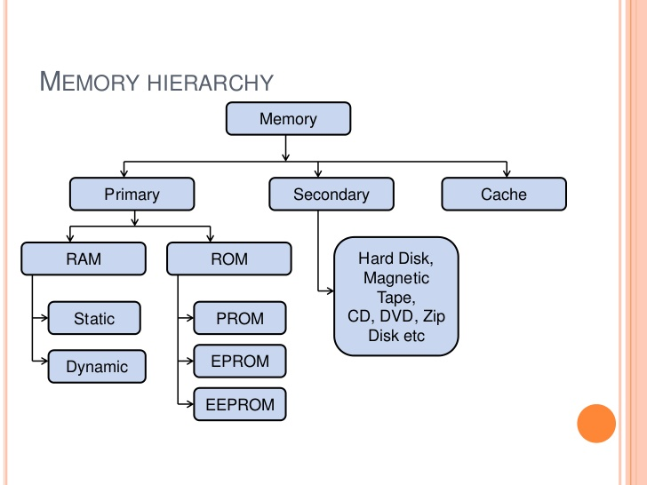
Memory

Slide 9

ACID PROPERTIES:
Atomicity
Consistence
Isolation
Durability

Slide 10

Terminologies:
Entity, Attribute, Tuple,
What is RDBMS and Relational database

Slide 11

Rule 0: The foundation rule:
Rule 1: The information rule:
Rule 2: The guaranteed access rule:
Rule 3: Systematic treatment of null values:
Rule 4: Dynamic online catalog based on the relational model:
Rule 5: The comprehensive data sublanguage rule:
Rule 6: The view updating rule:
Rule 7: High-level insert, update, and delete:
Rule 8: Physical data independence:
Rule 9: Logical data independence:
Rule 10: Integrity independence:
Rule 11: Distribution independence:
Rule 12: The nonsub version rule:

Slide 12
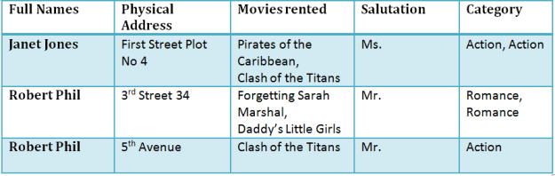
NORMALIZATION

Slide 13
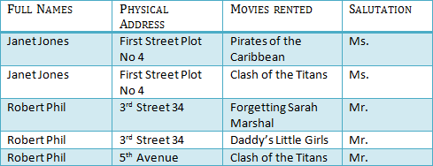
1NF (First Normal Form)
Rule 1- Each table cell should contain a single value.
Rule 2- Each record needs to be unique.

Slide 14

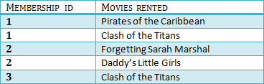
2NF (Second Normal Form)
Rule 1- Be in 1NF
Rule 2- Single Column Primary Key

Slide 15

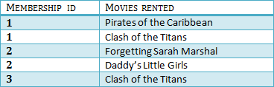

3NF (Third Normal Form) Rules
Rule 1- Be in 2NF
Rule 2- Has no transitive functional dependencies

Slide 16
Boyce- Codd Normal Form (BCNF)
Boyce- Codd Normal Form (BCNF) is one of the forms of database normalization.
A database table is in BCNF if and only if there are no non-trivial functional dependencies of attributes on anything other than a superset of a candidate key.
Sometimes is BCNF is also referred as 3.5 Normal Form.

Slide 17
APPLICATION
Application is a program designed to perform a group of functions, tasks or activities for the benefit of the user.
Examples of an application include a word processor, a spreadsheet, an accounting application, a web browser, a media player, an aeronautical flight simulator, a console game or a photo editor.
There are many types of application like
Desktop application
Web application
Android application etc..

Slide 18
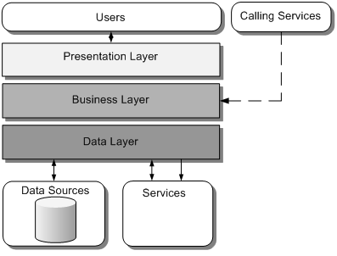
COMPONENTS OF APPLICATION
Presentation layer:
The presentation layer provides the application's user interface.
Business logic layer:
The business layer implements the business functionality of the application.
Data access layer:
The data layer provides access to external systems such as databases.

Slide 19
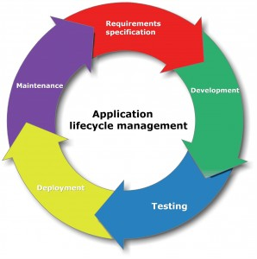

Slide 20
APPLICATION PROGRAM INTERFACE(API)
An application program interface (API) is code that allows two software programs to communicate with each other.
TYPES OF APPLICATIONS
Compiled | Interpreted
A compiled language is a programming language whose implementations are typically compilers translators that generate machine code from source code. | An interpreted language is a type of programming language for which most of its implementations execute instructions directly and freely, without previously compiling a program into machine-language instructions.
Example: C, C++ | Example: Java, C#

Slide 21
APPLICATION SECURITY
Application security is the use of software, hardware, and procedural methods to protect applications from external threats.
Attacks
SQL Injection
Cross-site scripting
Denial of Service
Session Hijacking

Slide 22
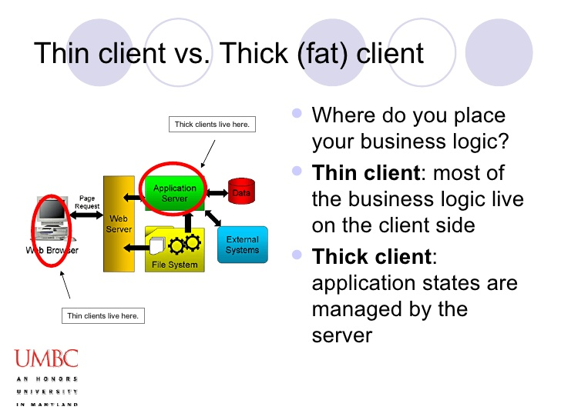
APPLICATION ARCHITECTURE TYPES

Slide 23
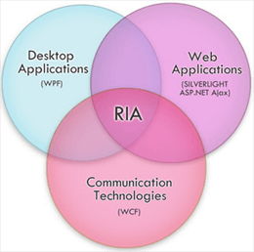
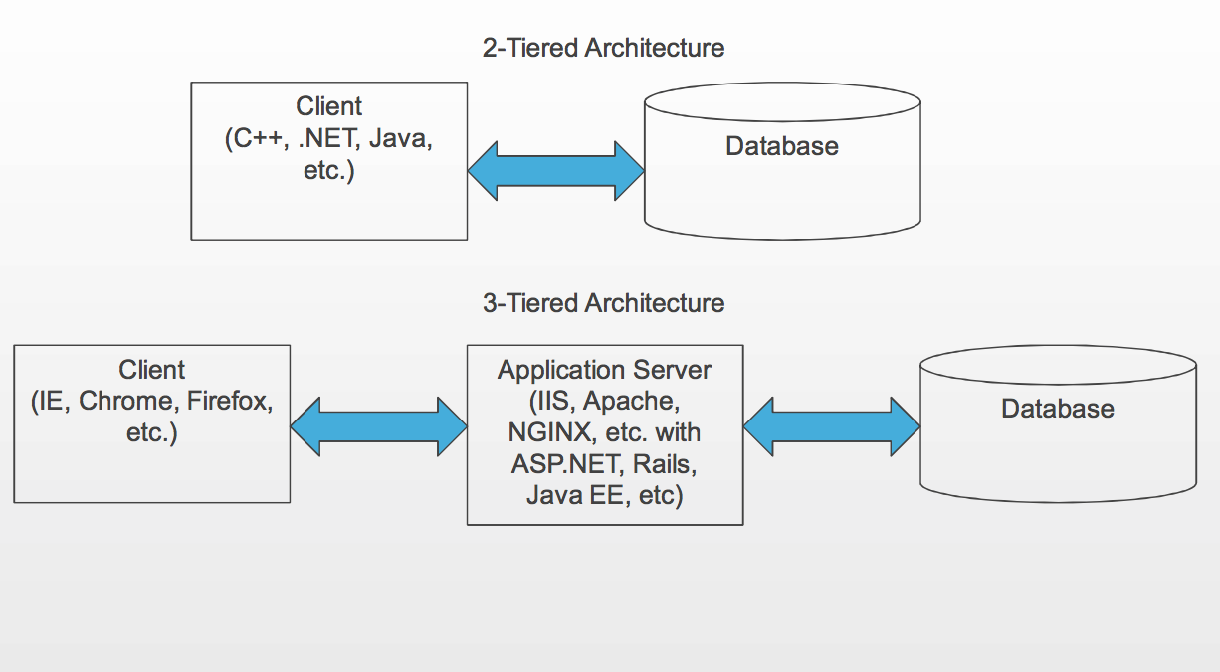
RICH INTERNET APPLICATION
TIER ARCHITECTURE

Slide 24
CHARACTERISTICS
ENTERPRISE APPLICATIONS
Enterprise applications are inherently complex.
Enterprise applications solve business problems.
This involves the safe storage, retrieval, and manipulation of business data.
Complex
Scalable
Component based
Distributed

Slide 25
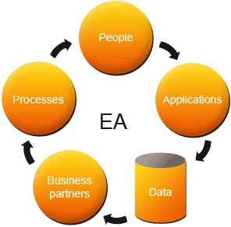
ARCHITECTURE OF ENTERPRISE APPLICATION

Slide 26
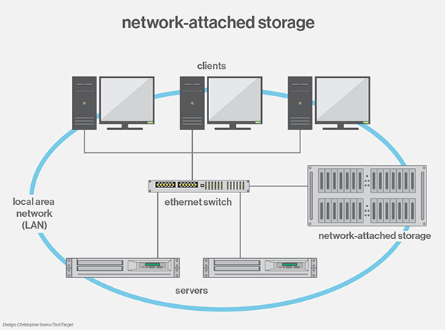
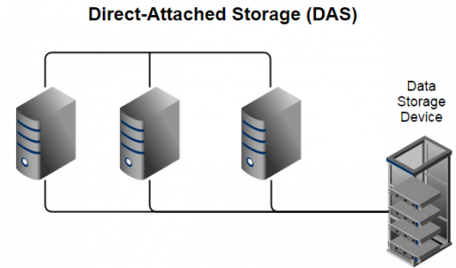
STORAGE

Slide 27
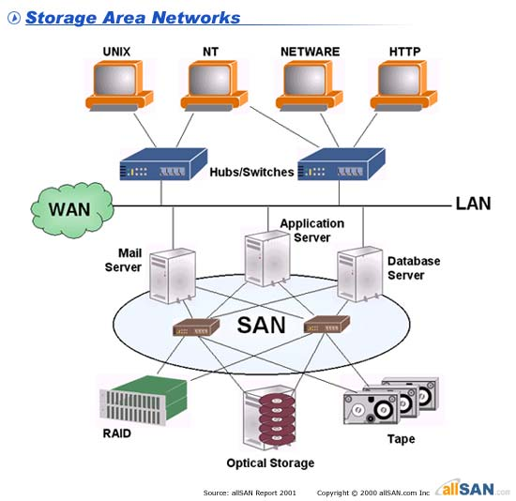
STORAGE AREA NETWORK

Slide 28
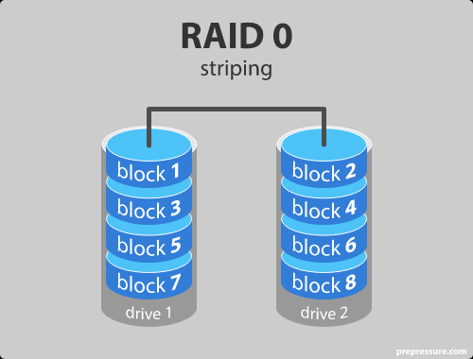
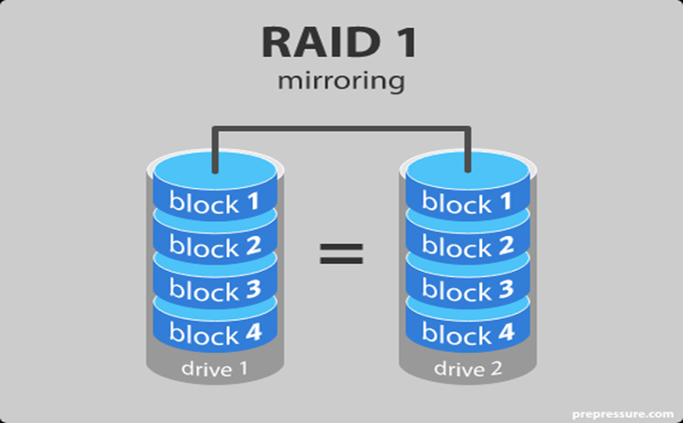
RAID
RAID is a technology that is used to increase the performance and/or reliability of data storage.
RAID LEVELS

Slide 29
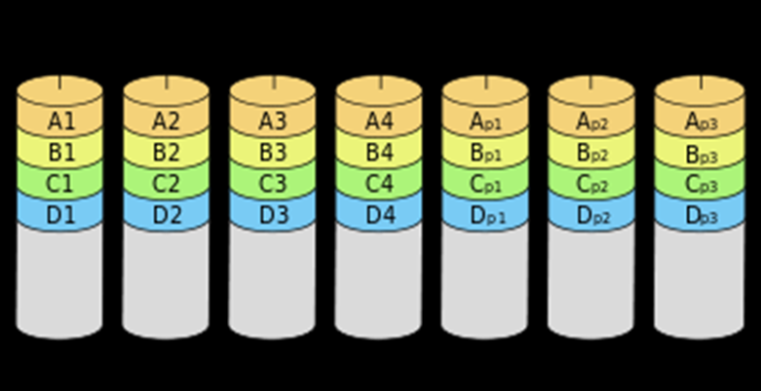
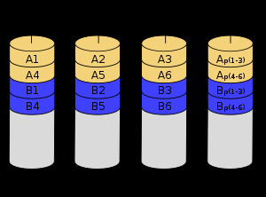
RAID LEVELS(Cont.)
RAID 2
Striping with ECC Checksum
RAID 3
Byte striping with parity

Slide 30
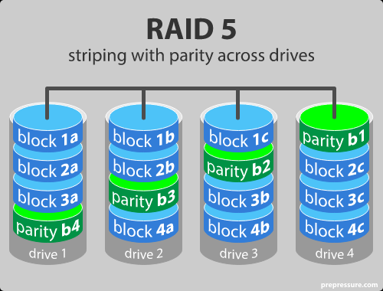
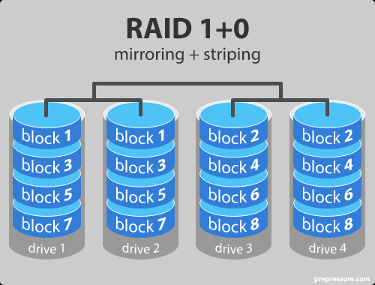
RAID LEVELS(Cont.)

